Slide 1
Recipe Preparation Agent
CAPSTONE PROJECT
Presented By: Argha Dalal
Student name : Argha Dalal
College Name & Department : University of Engineering and Management, Kolkata & Computer Science Engineering

Slide 2
OUTLINE
Problem Statement
Technology used
Wow factor
End users
Result
Conclusion
Git-hub Link
Future scope
IBM Certifications

Slide 3
Problem Statement
Many individuals, especially students and working professionals, struggle daily to decide what to cook with limited ingredients. Traditional recipe platforms often require complete ingredient lists or offer poor substitutions, leading to food waste and repetitive meals. Busy schedules, dietary needs, and budget limits make planning even harder. As a result, people often turn to unhealthy alternatives or skip meals. There’s a clear need for smart, flexible tools that suggest personalized recipes based on what's already in the kitchen.
Proposed Solution: The Recipe Preparation Agent is an AI-powered web app built with Node.js and IBM Granite LLM, using a RAG pipeline and IBM Watson tools. It accepts user-input ingredients to retrieve or generate suitable recipes, offering smart substitutions and cooking tips. The app also provides nutritional details and step-by-step instructions. Designed with a modern, mobile-friendly UI, it includes a convenient "Copy Recipe" feature for easy sharing.

Slide 4
Technology used
IBM cloud lite services
Natural Language Processing (NLP)
Retrieval Augmented Generation (RAG)
IBM Granite model

Slide 5
IBM cloud services used
IBM Cloud Watsonx AI Studio
IBM Cloud Watsonx AI runtime
IBM Cloud Agent Lab
IBM Granite foundation model

Slide 6
Wow factors
This AI agent will significantly reduce meal planning stress, help users make the best use of available groceries, promote healthier eating habits, and reduce food wastage by providing smart, personalized cooking recommendations.
Unique Features:
Ingredient-Based Recipe Generation Converts a list of available ingredients into complete, step-by-step recipes using AI.
Smart Substitution Engine Suggests intelligent ingredient replacements to accommodate dietary needs or pantry limitations.
Auto-Nutritional Insights Highlights basic nutrition facts (e.g., calories, protein, fat) for the suggested meal.
Context-Aware Cooking Tips Offers preparation tips and enhancements specific to the chosen recipe style or ingredient pairing.

Slide 7
End users
Home cooks and families
Students living away from home
Working Professionals
Anyone wanting to save time and reduce kitchen waste

Slide 8
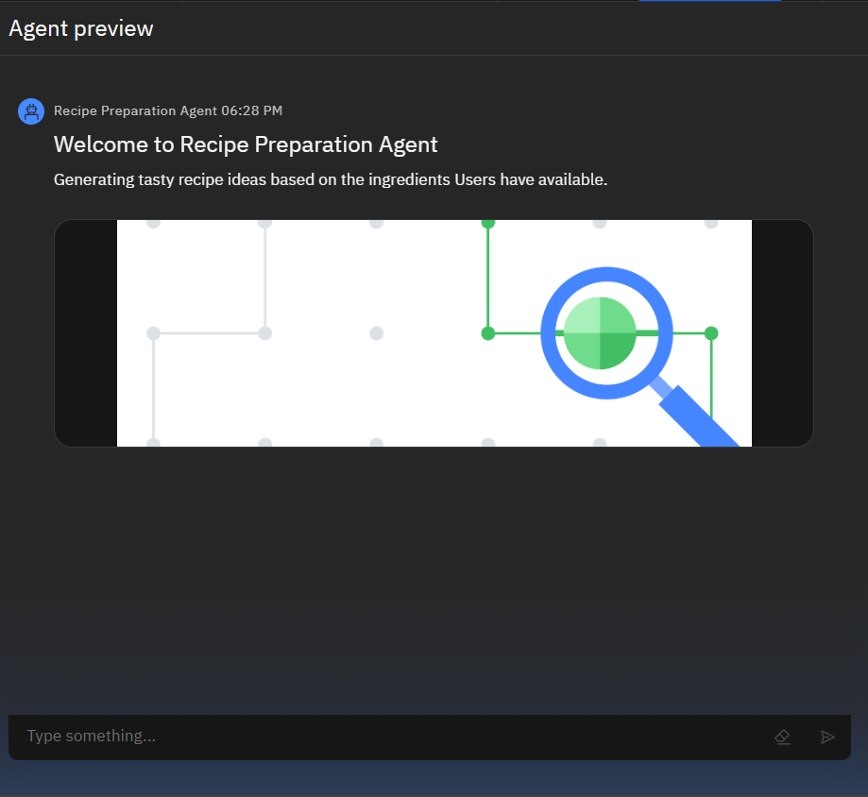
Results

Slide 9
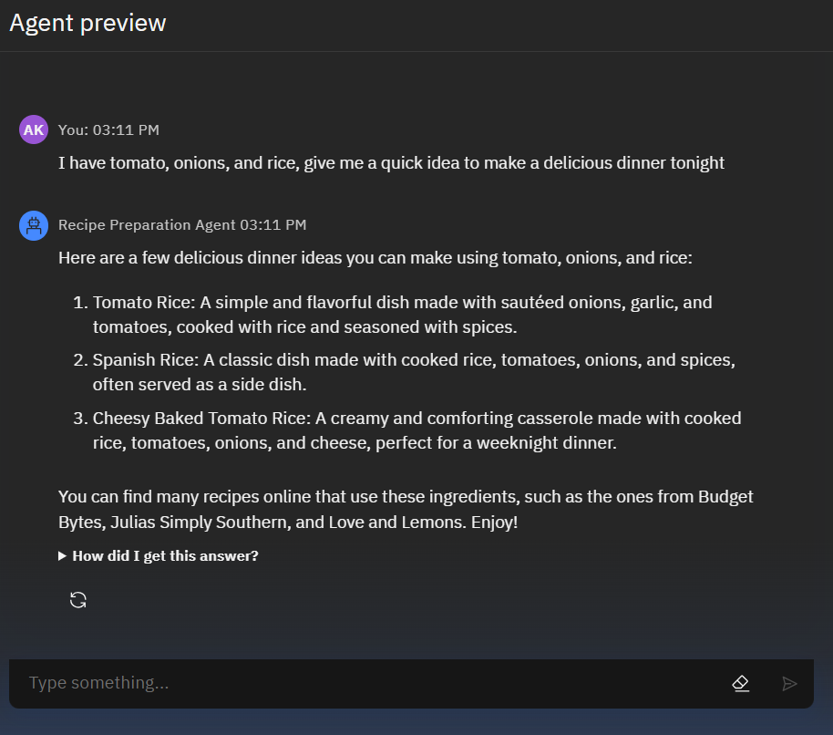
Results
AD

Slide 10
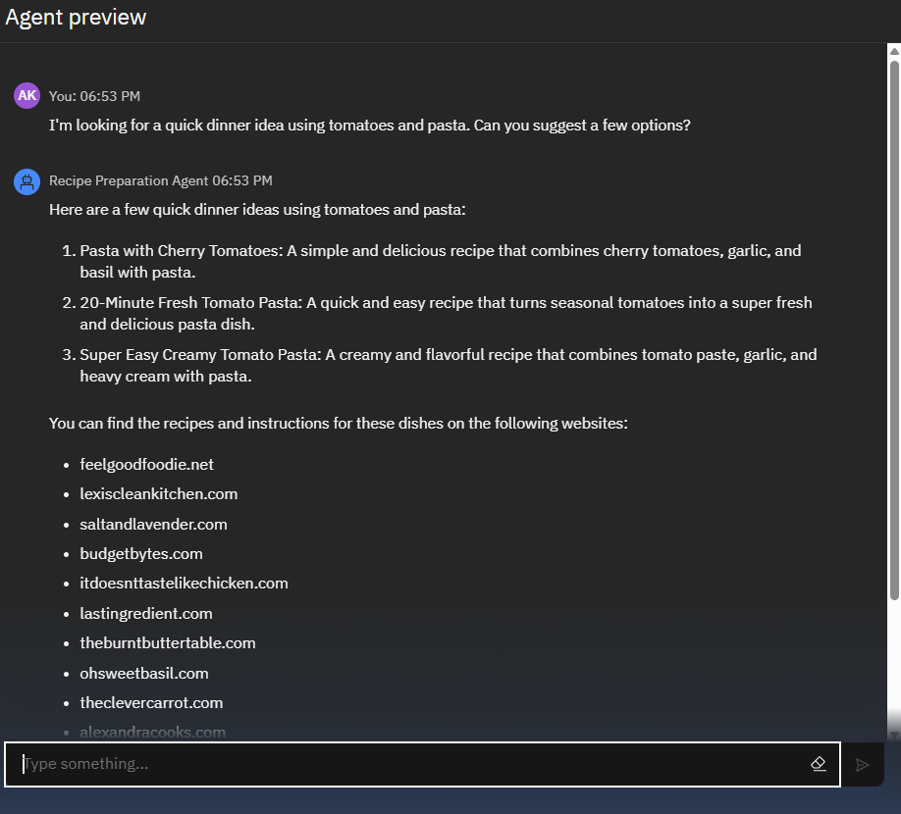
Results
AD

Slide 11
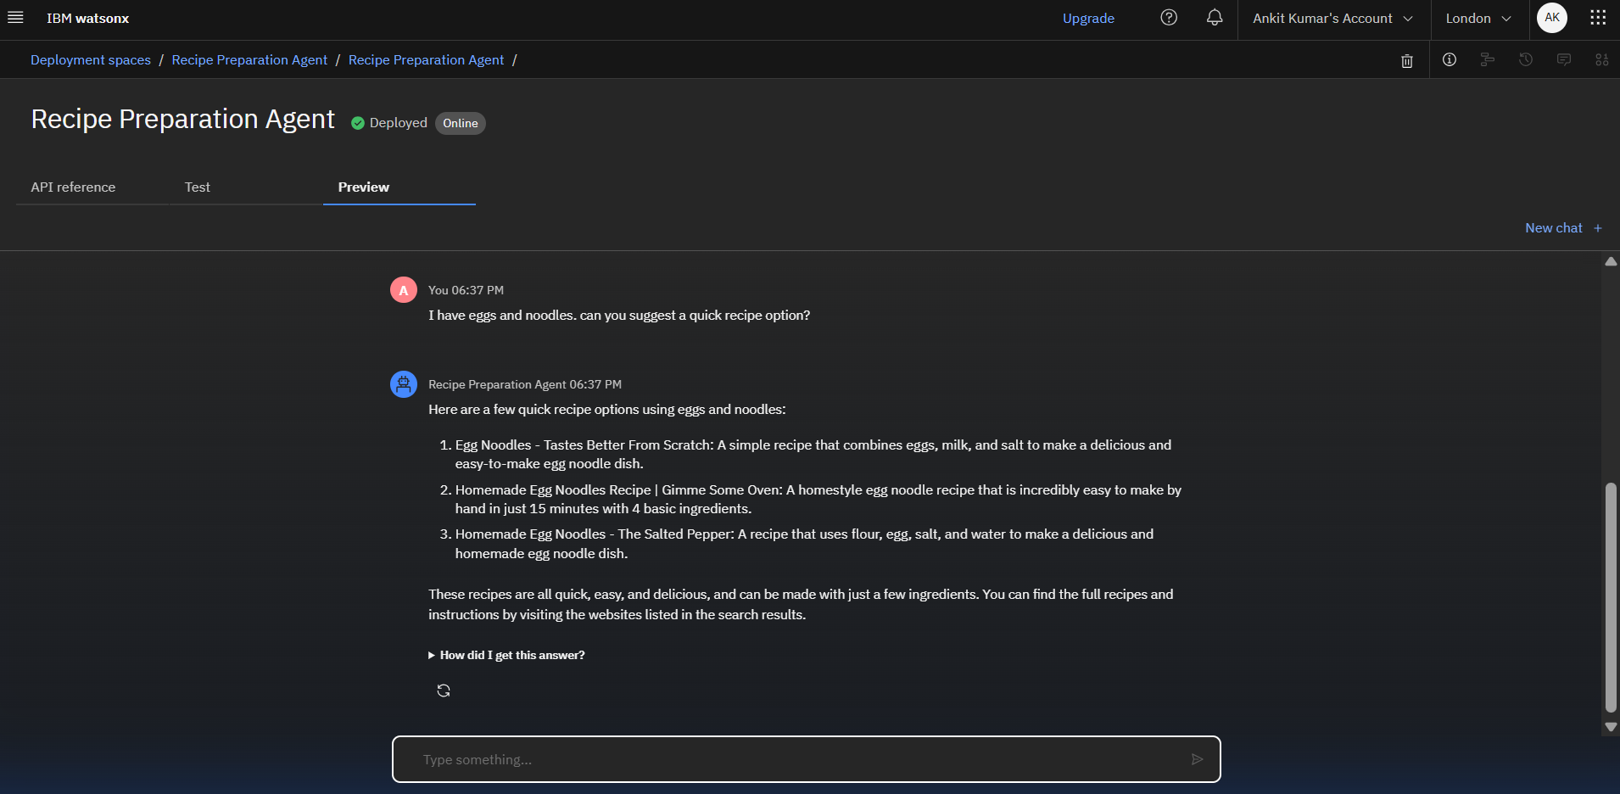
Results
Deployed AI Agent
AD

Slide 12
Conclusion
The Recipe Preparation Agent makes everyday cooking smarter, easier, and more sustainable by combining IBM’s AI capabilities with intuitive web technology. It bridges the gap between human creativity and machine intelligence in the kitchen, helping users reduce decision fatigue and food waste. The system promotes healthier, more personalized meal choices tailored to available ingredients.

Slide 13
Future scope
Multi-language support for regional users (Hindi, Bengali, etc.)
Image-to-recipe generation using food photos
Mobile app version with offline caching
Grocery list generator from selected recipes
Advanced nutrition tracking via barcode/grocery input

Slide 14
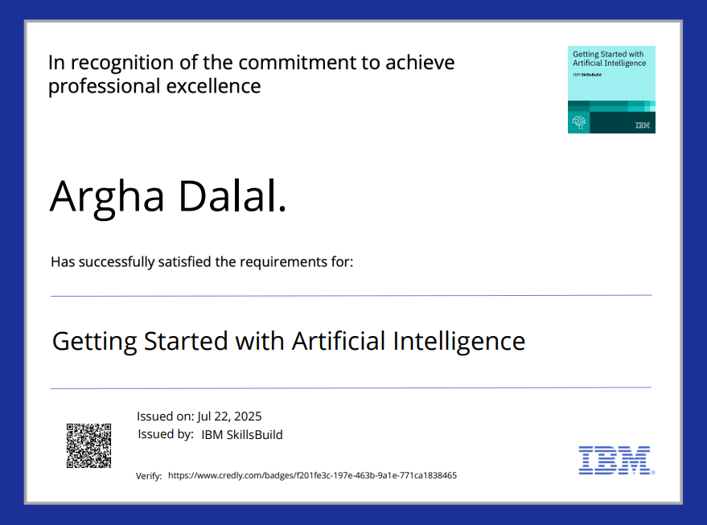
IBM Certifications
Screenshot/ credly certificate( getting started with AI)

Slide 15
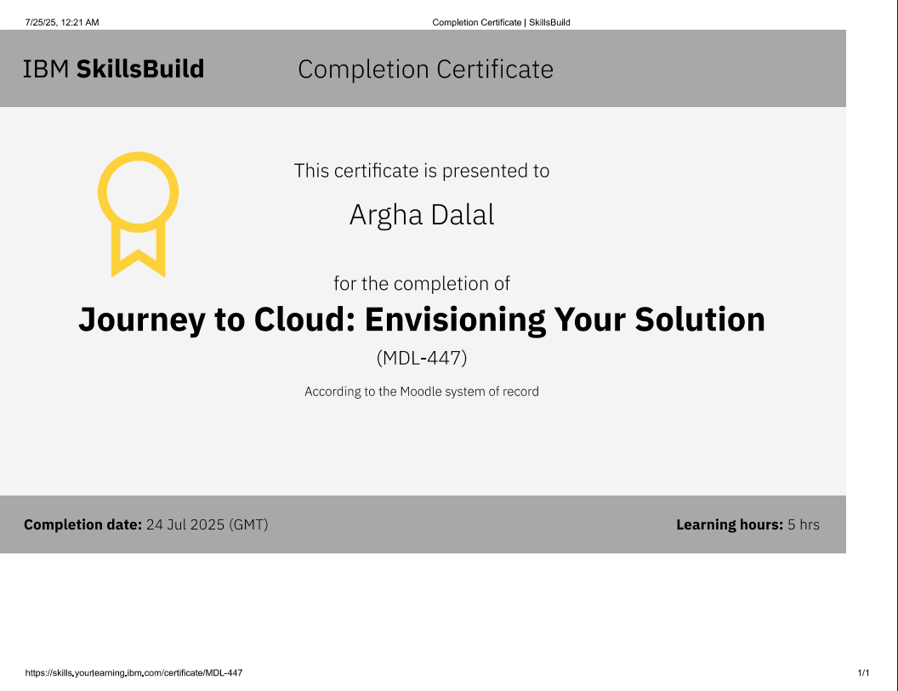
IBM Certifications
Attach your Cloud certificate here

Slide 16
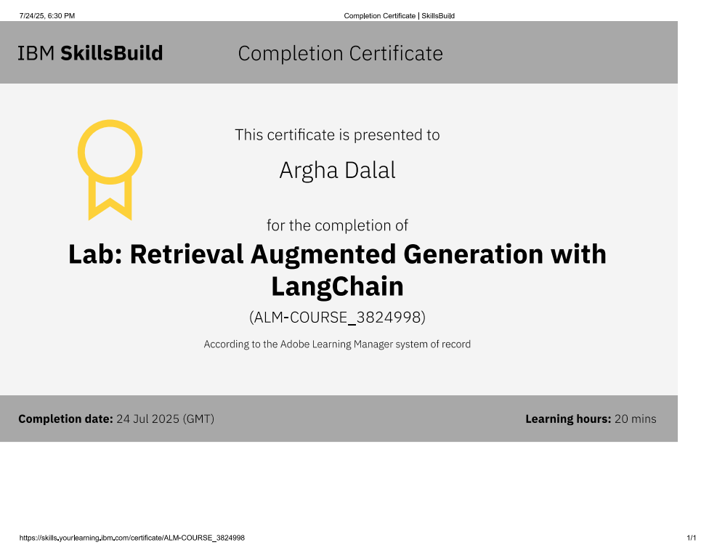
IBM Certifications
Attach your RAG LAB certificate here

Slide 17
GitHub Link: https://github.com/Argha0004/IBM-CLOUD-PROJECT--Recipe-Preparation-Agent

Slide 18
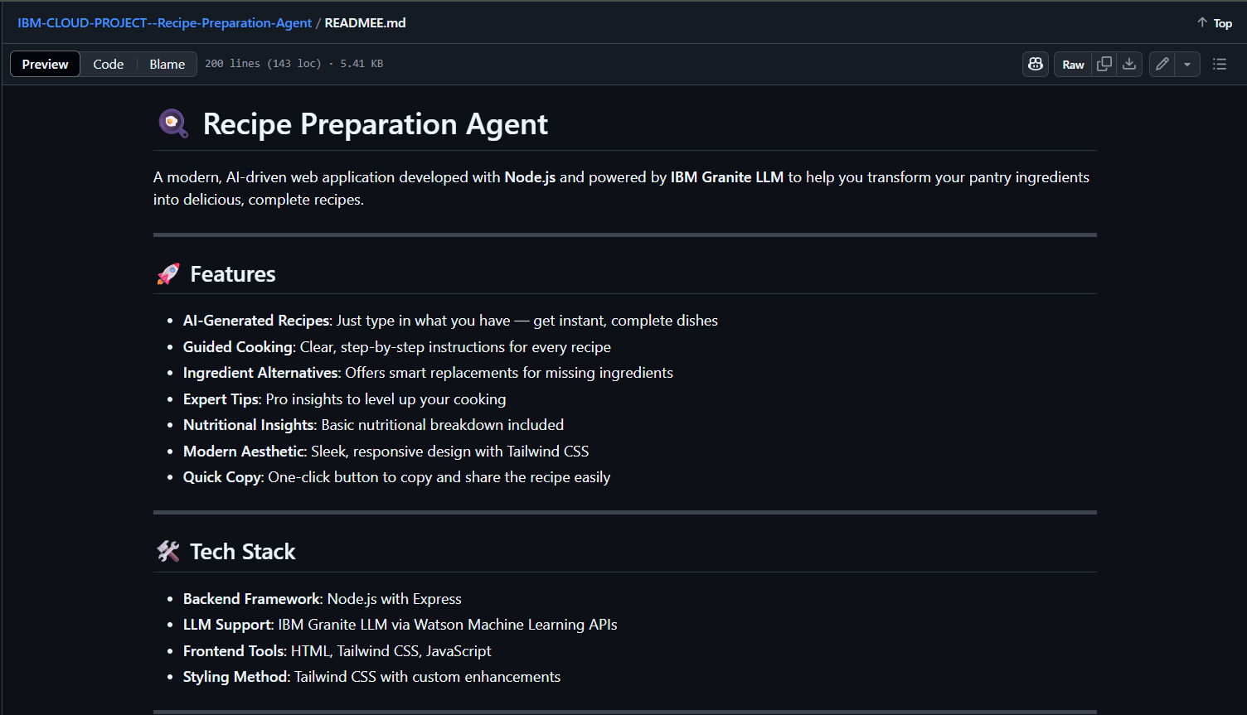
GitHub Link
Make sure that there should be readme file
- https://github.com/Argha0004/IBM-CLOUD-PROJECT--Recipe-Preparation-Agent

Slide 19
THANK YOU

